Slide 1
Social Development Bank Data
Presented by:
Abdulrahman Aleid Saad Alotaibi
Abdulmalik Alrebdi Lina Alhuri
Amal Alghamdi Sara Al-Qahtani

Slide 2
Table of contents
01.
02.
03.
Objective
Descriptive statistics
Data set description
04.
05.
06.
Data munging
EDA & visualization
Key takeaways
Where did our dataset come from?
Which questions can we answer?
What is the structure of our data?
What did we do to clean our data?
What can we say about our data?
What are the answers? Which challenges did we face?

Slide 3
Dataset description
01
Where did our dataset come from?

Slide 4
Our Dataset
Social Development Bank dataset is an open-source data provided by the Open Data portal of Saudi Arabia initiative. The social funding products are designed to target an important community segment in Saudi Arabia, the underprivileged citizens, offering them an opportunity to obtain simple and easy loans which enable them to meet necessary obligations.

Slide 5

Objective
02
Which questions do we attempt to answer?

Slide 6
Did the Social Development Bank (SDB) help promote and enhance the culture of innovation and entrepreneurship (e.g., productive families, small-to-medium enterprise (SME))?
Did the Social Development Bank (SDB) help increase the contribution of women to the economy?
Did the Social Development Bank (SDB) develop products specifically designed for low-income categories?
Did the Social Development Bank (SDB) enable the financial institutions to support the growth in the private sector?
Notes:
Vision 2030:
Did the Social Development Bank (SDB) help promote and enhance the culture of innovation and entrepreneurship (e.g., productive families, small-to-medium enterprise (SME))?
Did the Social Development Bank (SDB) help increase the contribution of women to the economy?
Did the Social Development Bank (SDB) develop products specifically designed for low-income categories?
Did the Social Development Bank (SDB) enable the financial institutions to support the growth in the private sector?

Slide 7
Descriptive statistics
03
What is the structure of our data?

Slide 8
Data Structure
Variable | Type | Definition
City | object | The city of the client to whom the loan was disbursed
Type of funding | object | Loan type (individuals, businesses, transfers)
Product | object | Type of loan disbursed to the client
Client sector | object | The sector in which the client works
The value of funding | float64 | Amount provided as a loan to the client
Premium value | object | Monthly payment amount
Exchange date | object | The month the funding was disbursed
Client's gender | object | Male or female
Age group | object | The age group to which the client belongs (youth, middle-aged adults, seniors, etc.)
Social status | object | Marital status or civil status of a person
Special needs | object | does the customer have special needs (yes, no)
Number of family members | object | Approximate number of members of the client's family
Savings loan | object | Is it saving loan? (Yes, no)
Value of income | object | Approximate monthly income of the customer
Income type | object | Categorize income into groups like (weak, medium, high, etc.)
The year | int64 | The year the funding was disbursed
16 Columns
180036 Rows

Slide 9
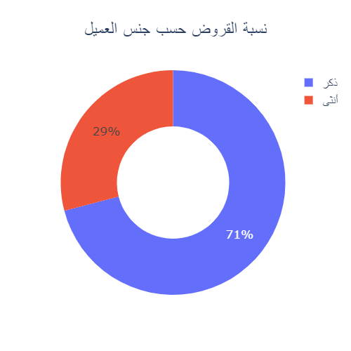
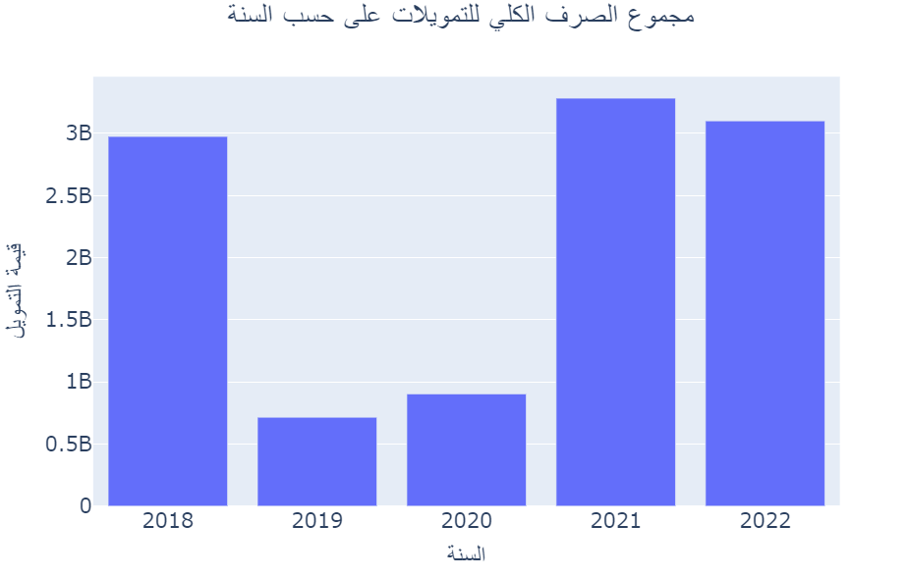
Budget & Gender
Notes:
The kingdom spends around 3 billion SAR yearly for loans, however, there is a sharp decrease in the budget allocated to loans in 2019 – 2020.
Annually, around two thirds of the social development bank budget are loans given out to males, while the remaining third to females.
The first quarter of 2022 indicates a good start, and it might signify that the loan budget might exceed the latest peak in 2021, which shows that the social development bank is including more Saudis into its social system by offering more loans.

Slide 10
Data munging
04
What did we do to clean our data?

Slide 11
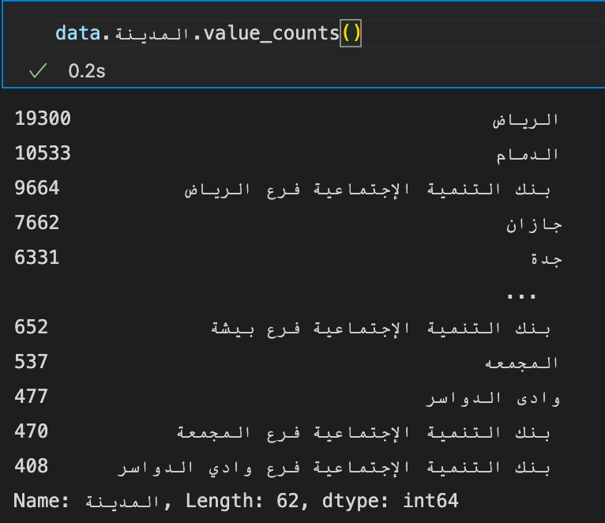
Data Preparation
Initial preparation for concatenation:
1.1. Unifying column names
1.2. Adding missing columns and filling them with ’غير معروف’
1.3. Rearranging columns for unification
Concatenation
Preparation for analysis:
3.1 Unifying values across each column across the years
3.2 Filling NaN values with “غير معروف”.
(2018-2020)
2021
2022
Notes:
Value counts of products or sectors

Slide 12
EDA & visualization
05
What does our data tell us?

Slide 13
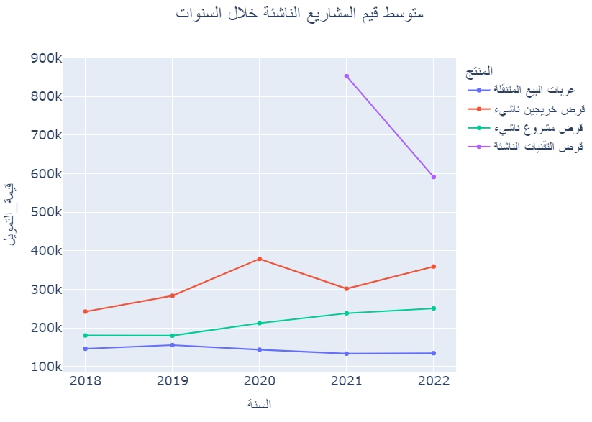
Did the Social Development Bank (SDB) help promote and enhance the culture of innovation and entrepreneurship (e.g., productive families, small-to-medium enterprise (SME))?
Age Group | Count
Youth | 2248
Adults | 1546
Middle age Adults | 659
Seniors | 26
Percentage of entrepreneurship loans: %8.42
Youth and Adult make the majority of entrepreneurship loans
Notes:
The social development bank encourages citizens in their 20-30s to become entrepreneurs by providing them with most business loans.

Slide 14
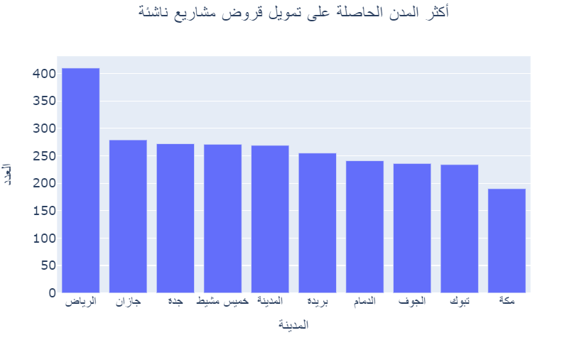
Income Group | Count
Very low | 3876
Low | 42
Middle | 16
High | 97
Riyadh is a hotspot for start-up companies with other smaller cities
Most SME loan applicants were from the low income group
Notes:
Social development bank also gives entrepreneur loans to applicant from smaller cities to help these cities grow.
Low-income applicants benefits the most from entrepreneur loans to increase their income.

Slide 15
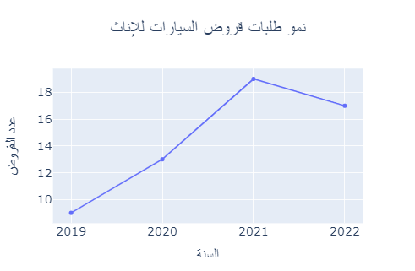
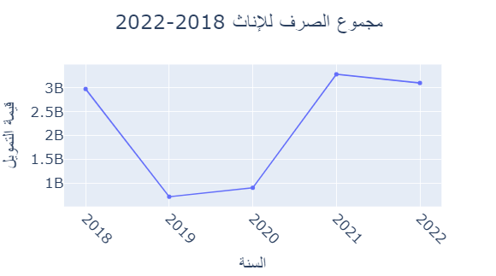
What are the demands of women from the SDB, and the contribution of women to economy?
After 2020 women contribution to the economy has increased
Women contributed to economy by taking out loans and spend them on the cars sector.
Women contributed to economy by taking out loans and spend them on the cars sector.
Notes:
1st graph:
- As of 2020, women's contribution to the economy has increased after a sharp decline in 2019-2020. That could be because of general budget cuts, where the kingdom started to tax people by 5%.
2nd graph:
- Women contributed to economy by taking out loans and spend them on the cars sector.
- The SDB was providing financial support by giving out car loans to women a year after women driving became legal in KSA.

Slide 16
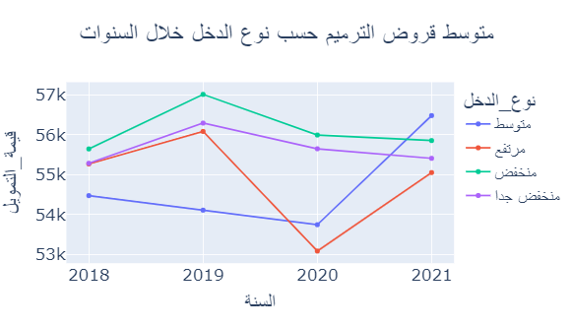
Did the Social Development Bank (SDB) develop products specifically designed for low-income categories?
Income Group | Count
Very low | 407
Low | 64
Middle | 153
High | 225
Both low and high income families benefit from renovation loans
Low and the very low income families receive the highest number of renovation loans they take 55-56K on average
Very low income get renovation loan more then any other category
Notes:
Renovation graph:
Renovation loans are given to both high- and low-income clients alike, however the low- and very-low-income seem to be the targeted population for this product because they receive the highest amount of money on average.
Income table:
People with very low income get renovation loan more then any other category which indicate that the SDB give this loan to the low income

Slide 17
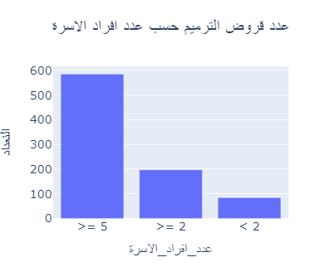
Did the Social Development Bank (SDB) develop products specifically designed for low-income categories?
The majority of people who got renovation loans are people with bigger families (5+ members).
The other family sizes combined account for the half.
Notes:
The majority of people who got renovation loans are people with bigger families (5+ members).
The other family sizes combined account for half the number of bigger families.

Slide 18
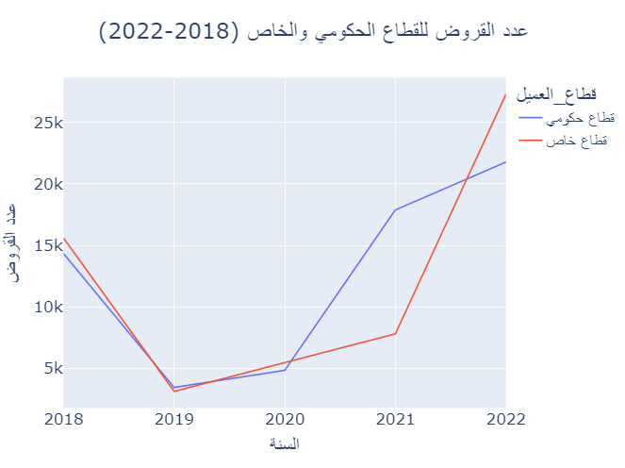
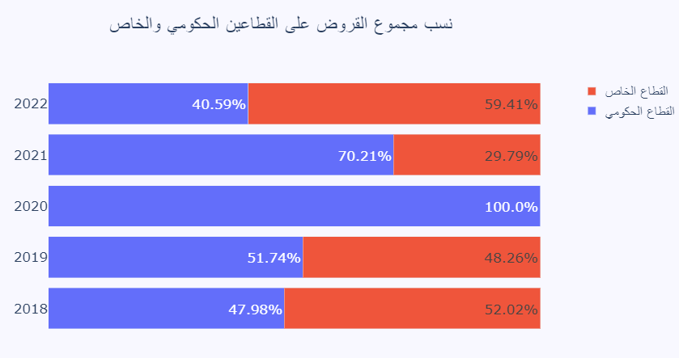
Did the Social Development Bank (SDB) enable the financial institutions to support the growth in the private sector?
There has been a decline in the years 2018 – 2020 for both the amount of loans given and the total spending
Especially in 2020 as the private sector was allocated no budget.
The amount of loans given for the private sector has more than tripled in the past year only, which indicates a potential future growth in the private sector.
Notes:
Massive growth in private sector’s loan counts in 2022 indicates an overall growth.
There has been a decline in the years 2018 – 2020 for both the amount of loans given and the total spending.
Especially in 2020 as the private sector was allocated no budget.
The amount of loans given for the private sector has more than tripled in the past year only.
Which indicates a growth in the private sector.

Slide 19
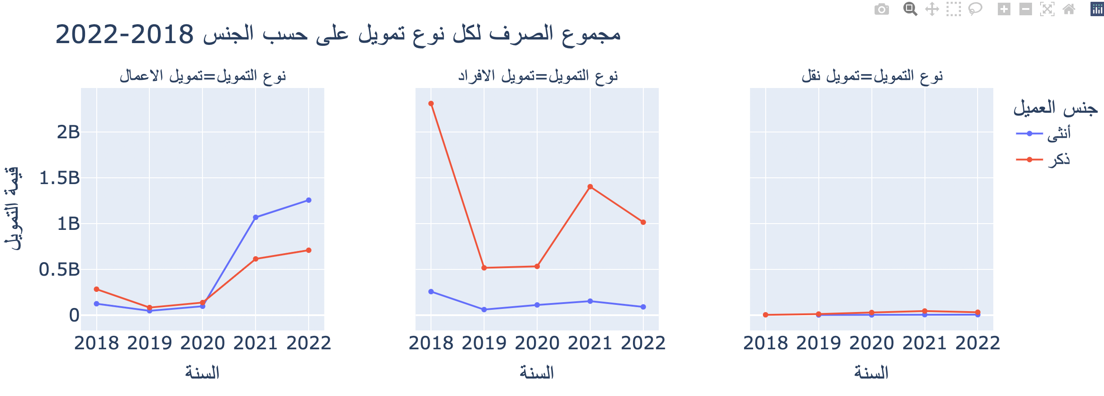
There is an increase in spending on business loans.
Individual loans spending has decreased.
Which indicates more focus on business loans and growing the private sector.
Most of the business loans in the last year is spent on woman.

Slide 20
Key takeaways
06
What are the answers? Which challenges did we face?

Slide 21
Key Takeaways
Social Development Bank (SDB) helps entrepreneurs by providing loans such as the start-up loans.
SDB is supporting women by providing them with more loans than ever.
Low-income people were also supported by the SDB through packages such as renovation loans
Social Development Bank (SDB) is supporting the private sector and contributing to its growth by spending more on business loans

Slide 22
Challenges & Team Contributions
Challenge #1
Data structure was not consistent across the years.
Challenge #2
There were many names for the same thing in column values.
Challenge #3
There is no direct way to deal with Arabic words.
Challenge #4
There is only on continuous variable in the dataset.
Notes:
Challenge#1:
Some columns were present in 2018-2020 but not in 2021 or 2022

Slide 23
Thanks!
Do you have any questions?

